Slide 1
Anti-Sybil Project
To Build an Intelligent Sybil Discovery LEGO
Trusta Labs
Notes:
Hello every one, here is demo video of our De-Sybil project to fulfill the FDD Hackthon.
The goal of our De-Sybil project is to build an intelligent Sybil discovery LEGO.

Slide 2
Introduction
Team
Deliverables (github & demo video)
Our Works
Data Preparation
Topic 1: Bulk Transfers & Donations
Topic 2: Sequential Behavior Pattern Mining
Topic 3 : Asset-Transfer Graph Mining
Topic 4: Grant Fraud
Summary, Suggestion and Future Works
Agenda

Slide 3
Team and Deliverables
Team
We are a team of web3 data scientists aiming at preventing sybil attacks. Before the Gitcoin Hackthon, we have already done a lot of preparations and related works, such as the Sybil analysis on HOP and Gnosis Safe airdrop. We position our work as the algorithmic detection LEGO in a Sybil resistance system although it means high development and maintenance cost.
Deliverables
The ppt contains our thinking, logic, methodology, algorithms and reasoning on a bunch of cases.
We have also uploaded the code to collect data, conduct feature engineering, compute risk score and Sybil clusters, and generate visualizations.
We keep on building an anti-sybil system. Look forward to collaborating with data scientists from Gitcoin community in Sybil hunting.

Slide 4
Introduction
Team
Deliverables (github & demo video)
Our Works
Data Preparation
Topic 1：Bulk Transfers & Donations
Topic 2: Sequential Behavior Pattern Mining
Topic 3: Asset-Transfer Graph Mining
Topic 4: Grant Fraud
Summary, Suggestion and Future Works
Agenda

Slide 5
Data Preparation
Table | Description | Size
grants_applications | grants info and description | 808
contributions_dataset | Contributions record | 475046
grants | List of grants | 1503
experiment_on_chain_data | On-chain info about a small number of contributors | 35
experiment_participant | Gitcoin info about some contributors | 119
experiment_passport_stamp | Passport info about some contributors | 574
experiment_vote | Vote record | 14562
ethereum_transfer | Ethereum transfers related to GR15 contributors | 8949267
polygon_transfer | Polygon transfers related to GR15 contributors | 10915653
zksync_transfer | Zksync transfers related to GR15 contributors | 2329056
contract_tag | Smart contract tags, e.g. opensea, binance | 594949
Collected Data
Gitcoin-Hackthon: GR15 donation detailed info GR_15_DATA
Alchemy: Ethereum and Polygon transfers related to GR15 contributors
zkSync: L2 transfers related to GR15 contributors
Chainbase: token prices in USD
DUNE: GR15 address tags from “GR15-bignode-name”
Statistics
-- 2022-09-07 15:00:00 ～ 2022-09-22 23:59:59 -- 1440 Grants and 55585 Contributor Addresses
-- 4 Chains (Ethereum L1, zkSync L2, Polygon and Celo) -- 38 tokens (Eth, USDT, USDC, DAI, MATIC, WETH, etc)
Notes:
Here are all the datasets that we used for our sybil detection program. The data sets, especially how did we generate them are valuable to Gitcoin. So we upload all the code and data to github. Part of the data comes from the GR_15_DATA, containing list of grants and their information, and GR15 contributions information. Besides, we obtain the Ethereum and Polygon transfers related to GR15 contributors from Alchemy and zySync from its api. Thanks to Chainbase and dune, we obtained the token price and some useful address tags. We also labelled some addresses and smart contracts by ourself.
Here is the quick statistics. The time of GR15 related data ranges from sep 7th to 22nd . There are 1440 grants and 55585 contributor addresses. The donation happened on 4 chains, that is ETH L1, zkSync L2, polygon and Celo, involving 38 tokens.

Slide 6
Introduction
Team
Deliverables (github & demo video)
Our Works
Data Preparation
Topic 1：Bulk Transfers & Donations
Topic 2： Sequential Behavior Pattern Mining
Topic 3 ： Asset-Transfer Graph Mining
Topic 4: Grant Fraud
Summary, Suggestion and Future Works
Agenda
Notes:
Let’s move to the first topic about how to detect sybil from their bulk operations.

Slide 7
Bulk Operations: Transfers & Donations
Bulk transfers
Bulk donations
EOA
Grant
EOA
To gain more illegitimate matching allocation
Airdrop
farmers
Grant
EOA
… …
Grant
EOA
On Gitcoin platform, the sybil attack means that a user spreads their funds across multiple addresses and makes donation to the same project(s). We propose to detect Sybils by examining
(Bulk Transfers) how the user spreads funds in a bulk way
(Bulk Donations) In what pattern they make donation to the same Grant(s)
Notes:
Let’s quickly have an understanding about Sybil attack. According to the quadratic form mechanism used to decide how matching funds should be distributed, using more addresses to donate can gain more illegitimate matching allocation. At the same time, airdrop farmers also make use of sybil attack to achieve the higher probability of getting grant airdrop.
To reduce operation costs, the user behind Sybils usually controls and manipulates a bunch of addresses, manually or by scripts and tools. On Gitcoin platform, they spread the funds across these addresses and then make donations to the same project(s). Therefore, we propose to detect sybils by examining (1) first, bulk transfers, meaning how the user spread funds in a bulk way and (2) second, in what pattern they make donations to the same Grant(s)

Slide 8
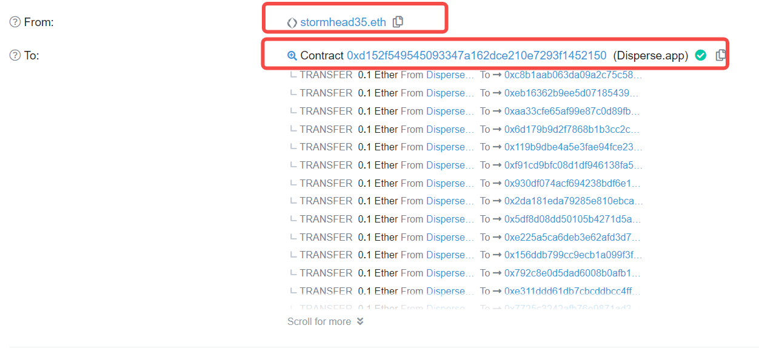
Bulk Transfers Mining
Bulk transfer for fund preparations
An Real Example
EOA
Grant 1
https://etherscan.io/tx/0xc7a81774fa3319cfc709c930607c28a4bc56660713357abf1717c2901d46a820
EOA
Bulk Transfer APP
EOA
… …
Grant 2
Fund Supplier
EOA
Goal
Have a better understanding of What tools and How the sybils use for their fund preparations
Collect all the related addresses and sort them in terms of their sybils risks
Notes:
Sybils usually make use of bulk transaction applications, such as bulk-account registration tools and bulk transfer tools. As shown in the diagram, a fund supplier can call the Bulk transfer application to transfer fund to multiple contributor addresses. Our idea comes from a real case when we explore the GR15 data where the disperse smart contract is used to transfer funds to a bunch of addresses, and many of these addresses made donations to GR15. You can refer to the etherscan to see the detail. Our work aims to (1)first have a better understanding of What tools and How the sybils use the tools for their fund preparations; and (2) Collect all the related addresses and sort them in terms of their sybils risks

Slide 9
Mining Pipeline
Select Bulk
Transactions & Transfers
Design and Compute
Sybil Scorecard from RIs
Design and Compute
Risk Indicators (RIs)
Notes:
Here is our mining pipeline. Firstly, we select all bulk transactions and transfers related to the GR15 contributors. Based on the 6 risk indicators designed and computed in the second step, we came up with a sybil scorecard finally.

Slide 10
Mining Pipeline
Select Bulk
Transaction & Transfers
Design and Compute
Sybil Scorecard from RIs
Design and Compute
Risk Indicators (RIs)
 | Txn_hash | From | Time | Transfers_List
 | XXX | XXX | XXX | {(to_addr1,amount1,) (to_addr2,amount2,) (to_addr3,amount3,) …}
… … A bulk transaction contains more than one transfers where all transfers have an identical sender address and every transfer may have different recipient address. So, We select Bulk Transfers in a table where (1) Every row corresponds to a bulk transaction (2) The single sender is recorded，as well as the time (3) A list of transfers where every transfer is represented by the to_addr, and amount
Notes:
The first step is to select bulk transfers. An bulk transaction allows a user to transfer funds to multiple recipient addresses from a single sender address. We select Bulk Transfers in a table where (1)Every row corresponds to a bulk transaction (2) The single sender is recorded，as well as the time (3) A list of transfers where every transfer is represented by the to_addr, and amount. Here is the what the table looks like.

Slide 11
Mining Pipeline
Select Bulk
Transaction & Transfers
Design and Compute
Sybil Scorecard from RIs
Design and Compute
Risk Indicators (RIs)
The Six Risk Indicators
NumOfContr: The number of contributors in a transaction
NumOfDistinctAmount: The number of distinct amount of transfers in a transaction
ContrRatio: The number of contributors divided by the total number of distinct recipients in the transaction
MaxAmount: The maximum amount of the transfers in the transaction
ContrAmountRatio: The total amount of donations divide by the total amount of transfers-in
GapDay: The time difference between the transfer and donation
the greater the indicator, the greater the risk
the greater the indicator, the less the risk
Notes:
Second, we design 6 risk indicators. The indicator design is based on our understanding of Sybil’s motivation and the exploration on the data. The three to the left are positively related to the risk of being Sybil. Taking the first one, NumOfContr as an example, if 100 contributors received fund in the same transaction, it is more likely to be Sybil than that of 10 contributors. The three to the right has the property that the greater the variable, the less the risk. For example, it is understood that Sybils may transfer the same amount of fund and the amount would be as small as possible. So, we design the variable representing “The number of distinct amount of transfers in a transaction”, and the variable representing “ The maximum amount of the transfers in the transaction”.

Slide 12
Mining Pipeline
Supervised Machine
Learning Algorithm
Select Bulk
Transaction & Transfers
Design and Compute
Sybil Scorecard from RIs
Design and Compute
Risk Indicators (RIs)
Scorecard Results:
There are 18926 contributor addresses related to bulk transfers.
Based on the 6 RIs, we manually designed a scorecard, and the score distribution is
We suggest that
Score >= 10 (705 addresses) , Risk = High
Score>7 and <10 , Risk = Medium
Score <= 7, Risk = Low;
Score | 0 | 1 | 2 | 3 | 4 | 5 | 6 | 7 | 8 | 9 | 10 | 11 | 12 | 13
NumOf Addr | 9 | 689 | 1181 | 1636 | 2978 | 3390 | 3407 | 2260 | 1337 | 1334 | 365 | 256 | 71 | 13
Notes:
There are 18926 contributor addresses related to bulk transfer. Based on the 6 RIs, we manually designed a scorecard. Here shown the distribution of the resulted scores. The greater the score, the greater the risk. We suggest that for the 705 addresses whose score is greater than 9, the risk of being Sybils is high. And for score 8 and 9; the risk is medium. And for addresses with score less than 8, there are no bulk transfer evidence to judge them as Sybils. Score card is known to be very heuristic. We do want to employ some supervised machine learning algorithm such as XGBT, SVM and DNN. But there are no sufficient grand truth Sybils. Anyway, it could be our future work to try supervised algorithms.

Slide 13
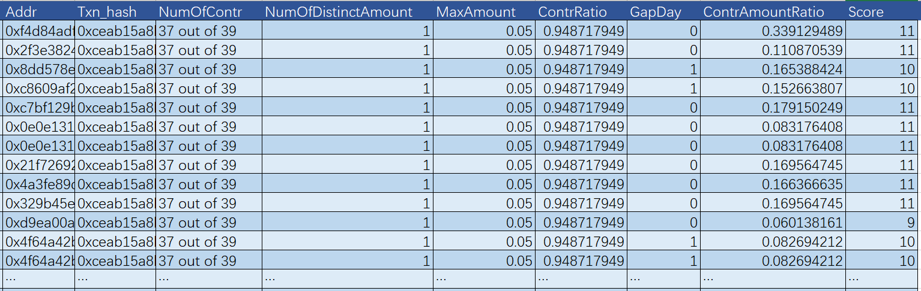
Example 1
Reasoning:
The transaction has 39 recipients, and 37 of them contributed to Gitcoin GR15. We report the 37 addresses out of 39 as a sybil cluster.
In the same transaction, they equally received 0.05ETH from the same sender. The transaction are called by the disperse app.
At the same day or one day later, they contributed to GR15.
According to the 6 Ris, the Score is mostly 10 and 11 indicating very high likelihood to be sybil
ClusterID: 32
ClusterSize: 37
Discovered by: bulk transfer
RiskLevel：High
Notes:
Here is an example of bulk transfer sybils. The transaction has 39 recipients, but 37 of them contributed to GR15. In the same transaction, they received funds from the same sender with amount being 0.05ETH equally. At the same day or one day later, they made donation to GR15. The 6 RIs are presented here and the Score is mostly 10 and 11, which are very dangerous.

Slide 14
Some Noteworthy Bulk Transfer Apps (1)
App | Smart Contract | Website | Description
multisender | '0xa5025faba6e70b84f74e9b1113e5f7f4e7f4859f' | https://multisender.app/ | Send ERC20 Token or ETH to thousands of addresses out in 1 single transaction with Token Multisender.
disperse | '0xd152f549545093347a162dce210e7293f1452150' | https://disperse.app/ | Distribute ether or tokens to multiple addresses
bulksender | '0xd1917932a7db6af687b523d5db5d7f5c2734763f' | https://bulksender.app/ | Token bulksender
aztec_v2 | '0xff1f2b4adb9df6fc8eafecdcbf96a2b351680455' | https://aztec.network/ | The programmable privacy layer for web3
across_v2 | 0x4d9079bb4165aeb4084c526a32695dcfd2f77381 | https://across.to/ | Across is a cross-chain bridge that prides itself on its speed, security and low fees.
gnosis_safe | '0x0094477dfd27b9d5dc7ba610f26f0dd4ae64db5b', '0x81b2e8b475295f4254a38433b6739efe270fc88b', '0xb32aebf09cb331f853536b4370be8acf2d886775', '0xa788e30d0cd4d15f2159c686ff2ce8cf4be2c125', '0xa653ecfdd7987dd9b6bc284c3abd22bdb199159c' | https://gnosis.io/safe/ | Smart contract-based multisig wallet
It is not necessary for an address to be a sybil if it uses these applications, but it is an importance signal.
Notes:
The table lists several typical noteworthy smart contracts for bulk transfer, discovered from the GR15 contributors.
Some of them are indicated from the name, for example, multisender, disperse, bulksender;
Aztec is a privacy-first zero-knowledge rollup on Ethereum; while across is a cross-chain bridge.
Notably，gnosis-safe is a multi-signature contract wallet. People can apply for a safe account and then use it’s bulk transfer feature.
It is not necessary for an address to be a sybil if it uses these applications, but it is an importance signal.

Slide 15
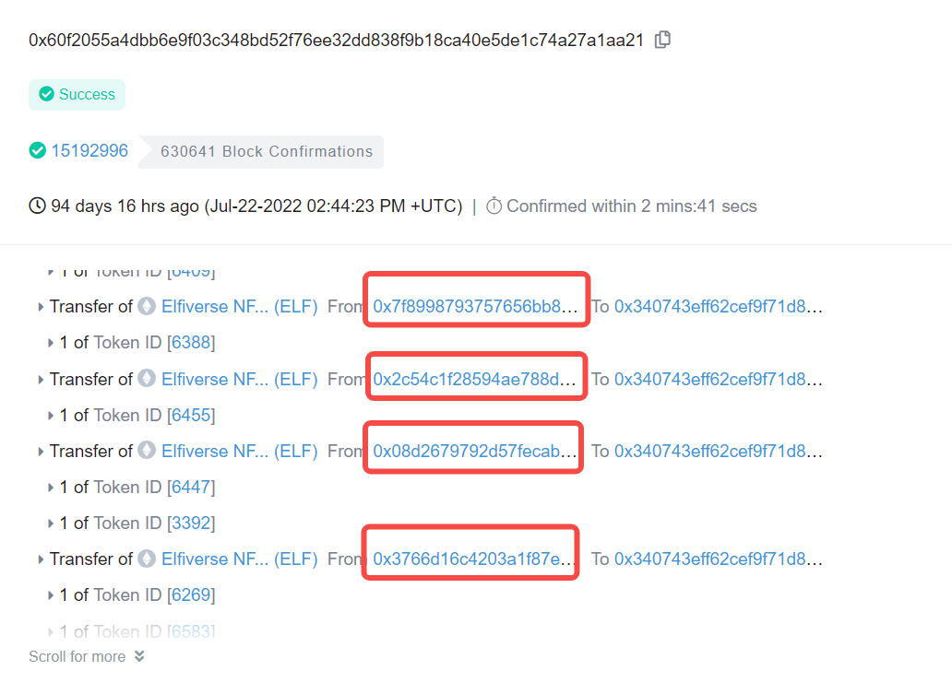
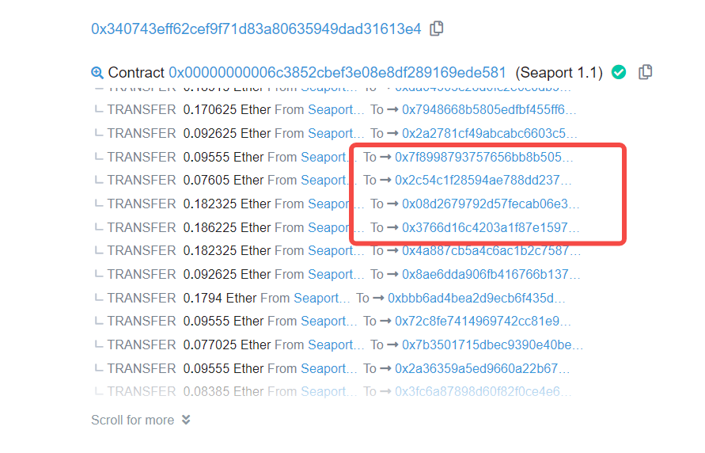
Some Noteworthy Bulk Transfer Apps (2)
NFT marketplace Apps
opensea&seaport, element_ex, ragnarok (Looksrare)，async.art, rarible. boredapeyogaclub_v2
Bulk NFT trades cause bulk fund transfers to contributors.
https://etherscan.io/tx/0x60f2055a4dbb6e9f03c348bd52f76ee32dd838f9b18ca40e5de1c74a27a1aa21
The contributors sold the same NFTs in one transaction. And then received funds from the same buyer simultaneously.
Notes:
Actually we found that several bulk transfer apps are NFT marketplaces, such as opensea and seaport, element, looksrare. It is because that bulk NFT trades causes bulk fund transfers to contributors. For example, these contributors bought the same NFTs in one transaction. And then received funds from the same seller simultaneously. We think this co-occurrence is also an important signal to notice.

Slide 16
Bulk Operations: Transfers & Donations
Bulk transfers
Bulk donations
EOA
Grant
EOA
To gain more illegitimate matching allocation
Airdrop
farmers
Grant
EOA
… …
Grant
EOA
On Gitcoin platform, the sybil attack means that a user spreads their funds across multiple addresses and makes donation to the same project(s). We propose to detect Sybils by examining
(Bulk Transfers) how the user spreads funds in a bulk way
(Bulk Donations) In what pattern they make donation to the same Grant(s)
Notes:
Now let’s move to the bulk donations topic to see in what pattern the Sybils make donations to the same grants.

Slide 17
Bulk Donations Mining: Data and Idea
The Idea
Attackers (or farmers) invest their time (to manipulate) and money (to donate) to perform Sybil attacks. Definitely they prefer to have a higher ROI (Return on investment).
Here are some assumptions as to greedy Sybils:
They donate the same grant
They donate as small amount as possible
They make use of script/tools to donate with the same parameter setting such as ChainID, Layer of Chain, token, amount
They donate in a sequential way, very closely
Table containing detailed contribution Information
Grant | txn_id | txn_hash | Time | Token | Amount | ……
Address 1
Address 2 | Table has the detailed contribution info with respect to a grant, such as the contributor address, txn ID and txn hash, the time of donation and the token and amount of the donation etc.
Address 3
……
Address m
Notes:
When attackers (or farmers) invest their time (to manipulate) and money (to donate) to perform Sybil attacks. Definitely they prefer to have a higher ROI. Here are some assumptions and heuristics about greedy Sybils to achieve higher ROI. First, they make donation to the same grant. And the amount of donation should be as small as possible. They make use of scripts/tools to make donation with the parameter settings unchanged to save time. The parameters are Chain ID, the Layer of the Chain, token, amount etc. Finally they make donations in a sequential way, with very close time interval. To encode our plain English assumptions as filtering condition, we first need a table as the one to the left. The Table has the detailed contribution info with respect to a grant, such as the contributor address, txn ID and txn hash, the time of donation and the token and amount of the donation etc.

Slide 18
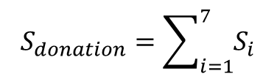
Indicators( Or Variables) and Scores
We encode our plain English assumptions as filtering variables
Var3：Group1Proportion
NumOfAddresses in Group1 divided by the total number of addresses in the grant
Var6：Q3TimeDifferences
The 3rd quartile (Q3) of the time differences between successive donations
Var7：CVTimeDifferences
The coefficient of variation of the time differences between successive donations
Var1：Amount
Var2：#ContributionsGroup1
NumOfContributions in Group1
Var5：Group2Proportion
NumOfAddresses in Group2 divided by the total number of addresses in the grant
Var4：#ContributionsGroup2
NumOfContributions in Group2
Grouping Criteria 1：
Grouping Criteria 2：
Same Grant
Same Network
Same Amount
Same Chain
Same Token
Same grouping criteria as of grouping 1
Time differences between two successive donations are <=30mins
Vars as Risk Scores from 1-5
Scoring donation and address
Percentile
Var2
Var3
Var4
Var5
Var6
Var7
$$S_{donation}=\sum_{i=1}^{7}{S_{i}}$$
Donation Risk Score：
0
10
30
50
75
100
5
4
3
2
1
Address Risk Score:
$$S_{address}=MAX（S_{donation 1},……,S_{donation n}）$$
Score
Var1（Amount）：
< 1U：5；>1U and <=1.1U：4；=1U：3；>1.1U and <=1.3U：2；>1.3U：1
Where donation 1 to donation n are donated by current address.
Notes:
Then 7 variables are computed from the table in order to implement our assumptions. In the same grant, we cluster donations with the same chain, network, token and amount into a group. In the group, we compute the number of contributions. The greater the value, the greater the risk. Also we compute the number of addresses in the group divided by the total number of addresses in the grant. This is also positively related to the risk. The second grouping criteria has a more strict condition besides those of group criteria 1, that is, to require the time differences between two successive donations being <=30mins. 4 variables are computed from group 2. Group2Proportion and #ContributionsGRoup2 are designed in a similar way as those in group 1. And Var6 computes the 3rd quartile (Q3) of the time differences between successive donations. And Var 7 computes the coefficient of variation of the time differences between successive donations.
Now we transform the variables to risk scores. Splitting the variables using their 3rd quartile, median, 30 percentile and 10 percentile as cut-offs results in the score from 1 to 5. For the amount variable, we manually define the splitting rule. With very simple logic and formulation, we compute the risk score for donations and addresses.
For any of the group, the amount variable is by default included.
selected possible Sybil in one group

Slide 19
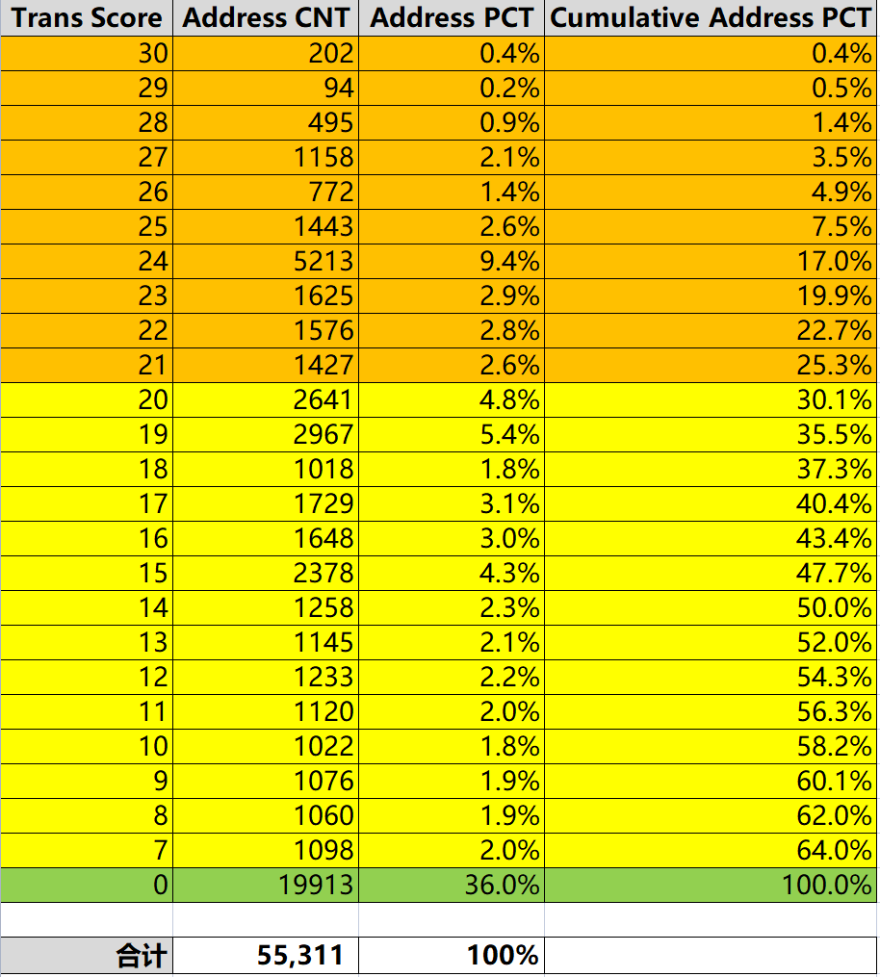
Results and Risk Level
Score Distribution
Risk Levels
High: Score >= 21
#OfAddress：14005，25.3%
Medium：Score < 21 and Score > 0
#OfAddress： 21393，38.7%
Low：Score = 0
#OfAddress： 19913，36.0%
** Note: the total number reported also includes results of another thread on bulk donations
** Score=0 are donations not likely to be sybils
Notes:
Here shown the distribution of the resulted scores. The greater the score, the greater the risk. We suggest that for the 14005 addresses whose score is greater than or equal to 22, the risk of being Sybils is high. And for score less than 22; the risk is medium. And for addresses with score 0, there are no bulk donation evidence to judge them as Sybils.

Slide 20
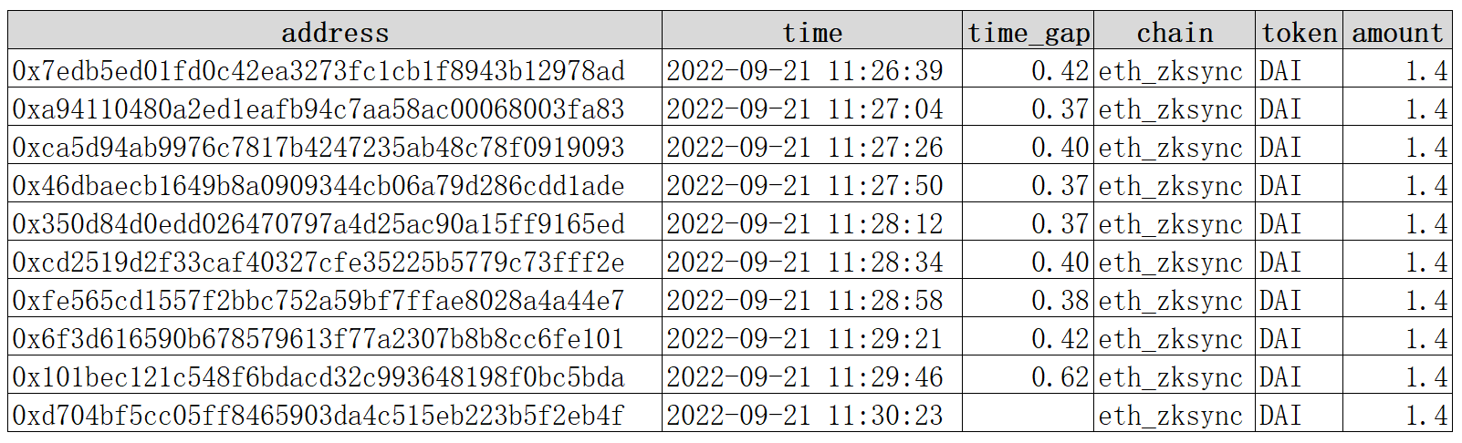
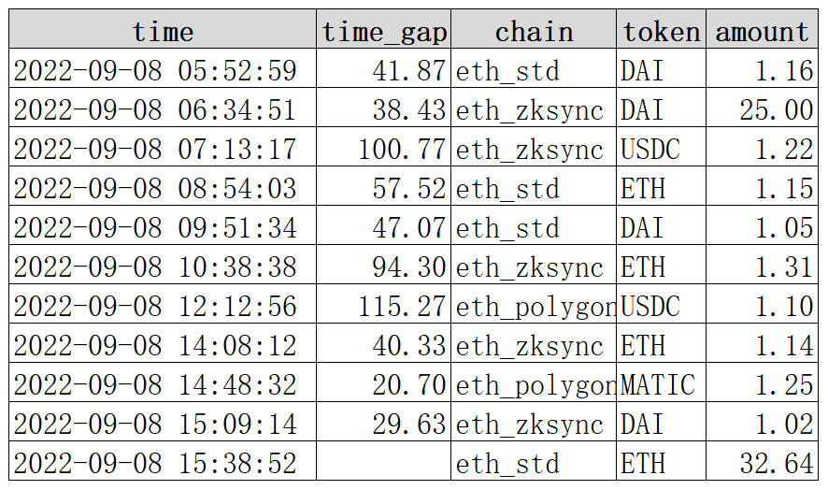
Example 1: Sybils Manipulated by the Same UserID
The 10 Sybil Donations
Reasoning
The same Gitcoin User (UserID= e18388e14838506df27f901c8b62de6c4fd6c
Da5b5e332e955b078fe6482bc96) made 10 donations to GrantID=7202 with 10 wallets. These happened in 4 mins, with a very close time interval = 30 secs between every two successive donations. Every wallet contributed 1.4U DAI on zkSync.
On the contrary, normal donations do not have apparent pattern in token aggregation, amount aggregation and chain aggregations. The time intervals between every successive donations are not all small.
Grant ID: 7202
Cluster ID: 77809
Cluster Size: 10
Discovered by: bulkdonation RiskLevel：High
Some Normal Donations
Notes:
Here is an example discovered from bulk donation analysis. In all the donations made to grant 7202, there are 10 possible Sybils. These sybil addresses are controlled by the same Gitcoin user with the UseID. The reason is that the 10 donations happened in 4 mins, with a very close time interval = 30 secs between every two successive donations. Every wallet contributed 1.4U DAI on zkSync. On the contrary, if we examine normal donations, we can see they do not have apparent pattern in token aggregation, amount aggregation and chain aggregation. The time intervals between every successive donations are not all small.

Slide 21
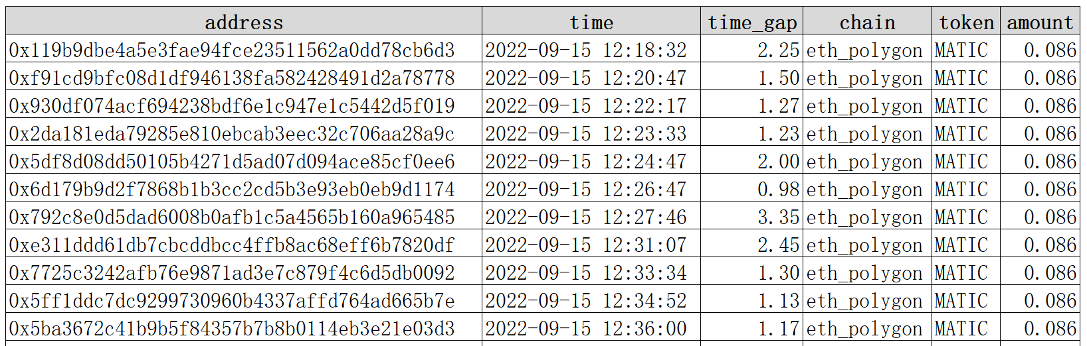
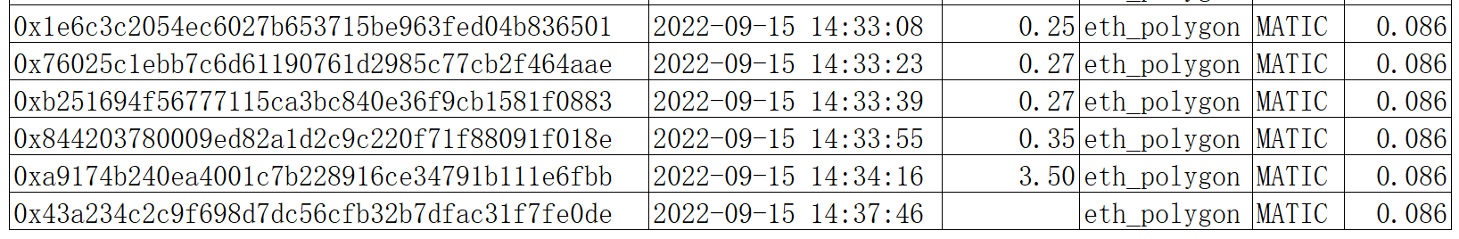
Example 2: Donations with Same & Small Amounts
Reasoning
Within about 2 hours, there are 61 donations to Grant 6713. The time intervals are as small as 30 secs to 1 minute. Every addresses donate 0.086U MATIC on polygon.
Grant ID: 6701
Cluster ID: 250829
Cluster Size: 61
Discovered by: bulkdonation RiskLevel：High
……
Notes:
Here is some donations made to grant 6701. You can see that Within about 2 hours, there are 61 donations. The time intervals are as small as 30 secs to 1 minute. Every addresses donate 0.086U MATIC on polygon.

Slide 22
Introduction
Team
Deliverables (github & demo video)
Our Works
Data Preparation
Topic 1：Bulk Transfers & Donations
Topic 2： Sequential Behavior Pattern Mining
Topic 3 ： Asset-Transfer Graph Mining
Topic 4: Grant Fraud
Summary, Suggestion and Future Works
Agenda
Notes:
Now let’s talk about an advanced topic, that is sequential behavior pattern mining.

Slide 23
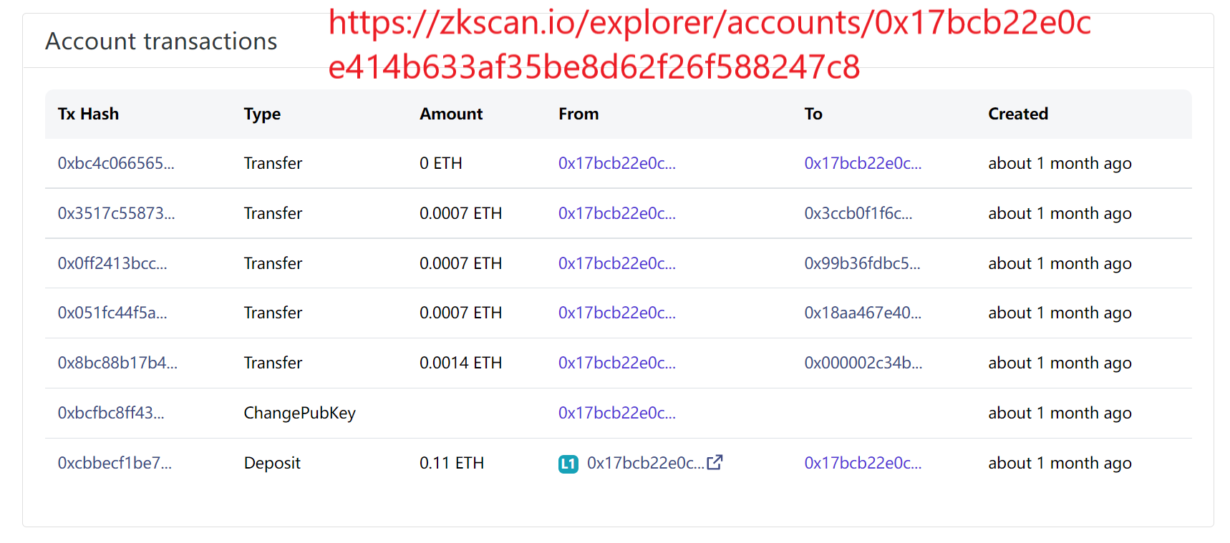
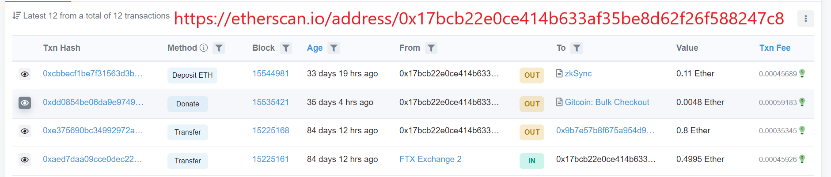
Sequential Behavior Pattern Mining
 | Possible On-Chain Activities
 | Transfer Asset | Interact with SC | Mint NFT | Claim Airdrop | Donate Gitcoin | …
In the form of transactions, event, log, internal call
Make EOA(address) behavior computable so as to facilitate sybil discovery
Sequential Behavior
Representation
Sequential Behavior
Similarity Computation
Usecase 1
Searching
Usecase 2
Clustering
Notes:
An address can transfer digit assets, interact to/with smart contracts, mint NFT, claim airdrop, make donation to gitcoin grants etc. Due to the transparency of the blockchain, all the activities are publicly available in the form of transactions, event log, internal call. One can manually retrieve an address’s behavior on etherscan/polyscan/zkscan. Taking the addresses 0x17bc as an example. Retrieving the address on etherscan and zkscan returned the following information. However, it is not trivial to collect, interpret and combine an address's cross-chain behaviors.
Our goal is to make address behaviors computable, so that we can use them to discover sybils. In the following, we first formally represent on-chain sequential behaviors and then define their similarities. This can be used in two usecases, for searching and clustering respectively. Both usecases can facilitate sybil discovery.

Slide 24
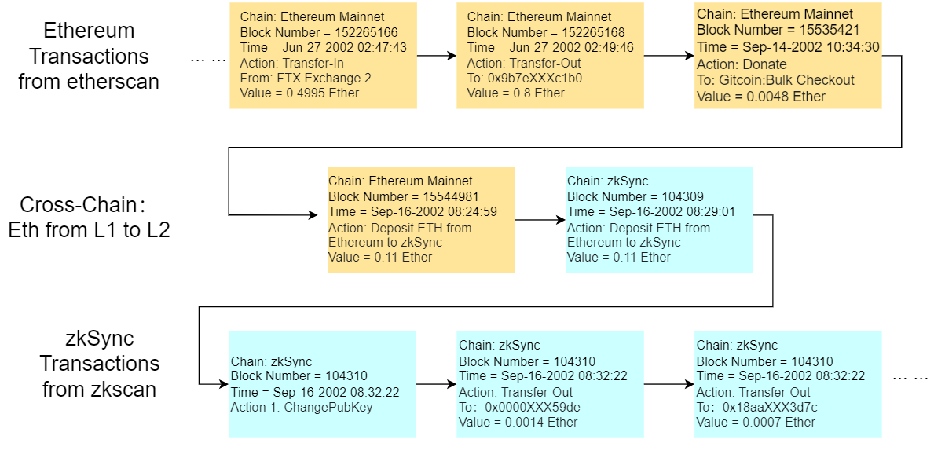
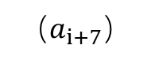
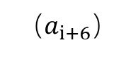
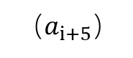
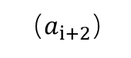
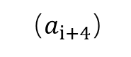
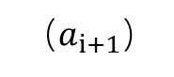
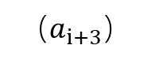
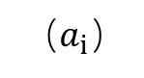
Sequential (Cross-Chain) Behavior Representation
（$a_{i}）$
（$a_{i+1}）$
（$a_{i+2}）$
（$a_{i+3}）$
（$a_{i+4}）$
（$a_{i+5}）$
（$a_{i+6}）$
（$a_{i+7}）$
Notes:
Here is how we design the data structure for sequential behavior representation. You can see a series of actions performed by an address. The yellow actions happened on Ethereum L1 while the blue ones on zkSync. In every action, the chain name indicates where it happened and the block number(the time) indicates when it happened. What the action essentially is is represented by the (action, from, to, value). Remarkably, the cross chain behaviors are concatenated in the second line where the Ethereum address deposited 0.11 ETH to its zkSync address, and the zkSync address successfully received the deposit from Ethereum 4 mins later.

Slide 25
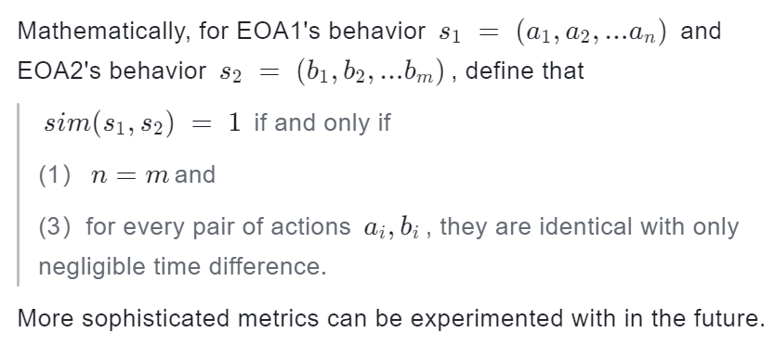
Similarity Definition
Notes:
Here is the similarity used in our analysis. The 2 addresses has similarity equals 1 if and only if they perform the same series of actions on chain, but maybe has a little negligible time differences. Actually more sophisticated metrics can be experimented with in the future. For now, even with this rigorous metric, we still have got some interesting use cases and findings.

Slide 26
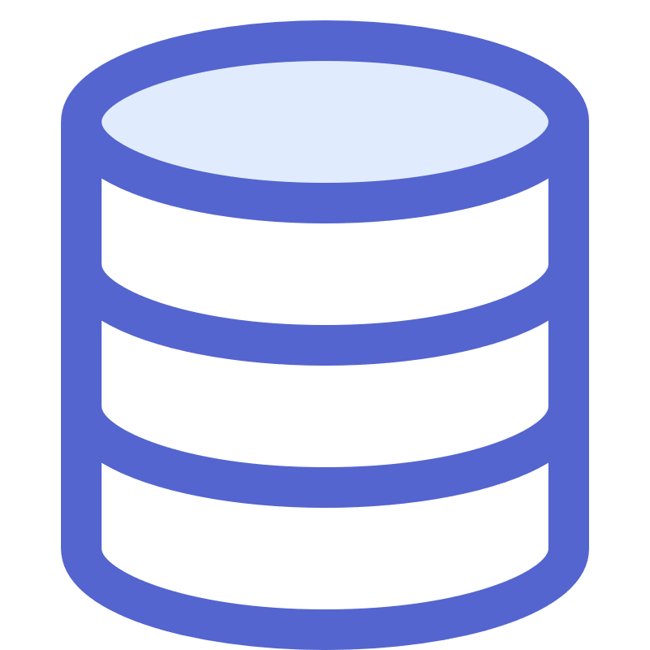

Use Case 1: Searching
{ Chain:ETH；Blocknumber:15392994；
time：2022-08-23 06:47:00；
to：0xd93206bd0062cc054e397ecccdb8436c3fa5700e；
Action：0x42842e；value：0.0}
{ Chain:ETH；Blocknumber:15392994；
time：2022-08-23 06:47:00；
to：0xd93206bd0062cc054e397ecccdb8436c3fa5700e；
Action：0x42842e；value：0.0}
Hi Gitcoin. Watch out!
Here is a suspicious contributor
{ Chain:ETH；Blocknumber:15392994；
time: 2022-08-23 06:47:00；
to：0xd93206bd0062cc054e397ecccdb8436c3fa5700e；
Action:0x42842e；value：0.0}
0x0aa599d8a9a1
418dc2df0bf240
95f7d87c0b1929
{Chain:ETH；Blocknumber:15392994；
time：2022-08-23 06:47:00；
to：0xd93206bd0062cc054e397ecccdb8436c3fa5700e；
Action: 0x42842e；value：0.0}
{Chain:ETH；Blocknumber:15392994；
time:2022-08-23 06:47:00；
to: 0xd93206bd0062cc054e397ecccdb8436c3fa5700e；
Action: 0x42842e；value: 0.0}
{Chain:ETH；Blocknumber:15392994；
time：2022-08-23 06:47:00；
to：0xd93206bd0062cc054e397ecccdb8436c3fa5700e
Action：0x42842e；value：0.0}
INPUT an address, OUTPUT the list of addresses having almost the same on-chain behaviors
Notes:
With the address representation and similarity computed, the first use case is to develop a search engine. So that, if Gitcoin have been reported a suspicious contributor, it can be input to the search engine. Eventually, the list of addresses having almost the same on-chain behaviors can be presented.

Slide 27
Use Case 2: Clustering
Sequential Behavior Representation
Similarity Definition
Clustering：A variety of distance-based algorithms such as spectral clustering, hierarchical clustering can be used. Here, Connected Component Based Clustering,
If (A,B) in a cluster; (B,C) in a cluster, then
(A,B,C) are all in the same cluster
Result in 115 clusters with size >=5
Cluster Size | [2,5) | [5,10) | [10,20) | [20,30) | [30,40) | [40,50) | [50,60) | =75 | =192 | >=5 Total
# of CLusters | 380 | 74 | 19 | 8 | 6 | 3 | 3 | 1 | 1 | 115 Clusters (1669 Sybils)
Notes:
With what we have, we conduct clustering on the GR15 contributors. Clustering is a useful exploratory technique to find clusters of addresses with very similar behavior. A variety of distance-based algorithms such as spectral clustering, hierarchical clustering can be used. Here, we used connected component based clustering as a first attempt. That is, if A and B are in one cluster; and B and C are also in one cluster, then we say A,B and C are all in the same cluster. Applying this simple rule, we have got 115 Clusters with Cluster Size > 4. Here is the distribution of the cluster size. Totally there are 1675 Sybils.

Slide 28
Example 1
The Cluster of Size = 75 | # of Actions
1 | 4
2 | 4
3 | 4
… | 4
… | 4
… | 4
… | 4
74 | 4
75 | 4
Reasoning
All these addresses has only 4 actions. Apparently from etherscan, the four actions are
127 days ago
Transfer in from Binance
127 days ago
Deposit ETH to Arbitrum
127 days ago
Send to L2 via HOP Ethereum Bridge
41 days ago
Donate to Gitcoin: Bulk Checkout
ClusterID: 32
ClusterSize: 75
Discovered by: behavior
RiskLevel: High
Notes:
We examine the second largest cluster, namely the cluster with size = 75.
https://etherscan.io/address/0xdccd3af19a82cd2c55d2dcb1f71043b412af8449
https://etherscan.io/address/0x755cb2b64ba078629052d7a9549191bb2bf75dd7
https://etherscan.io/address/0x14d51e464f88ae509078c05f126f4c01f6d144a8
https://etherscan.io/address/0xb4bb2a173bdcc3a46d81d8f90bca7e148a0fd265
https://etherscan.io/address/0x263cf481dc1f8ab7fd42ee75ea65cc904c225d2e
All these addresses has only 4 actions. Apparently from etherscan, the four actions are transfer in fund from binance, deposit to Arbitrum, and send to L2 via HOP Ethereum brigde. All these three actions happened 127 days ago. And finally at 41 days ago, they all made donations to Gitcoin.

Slide 29
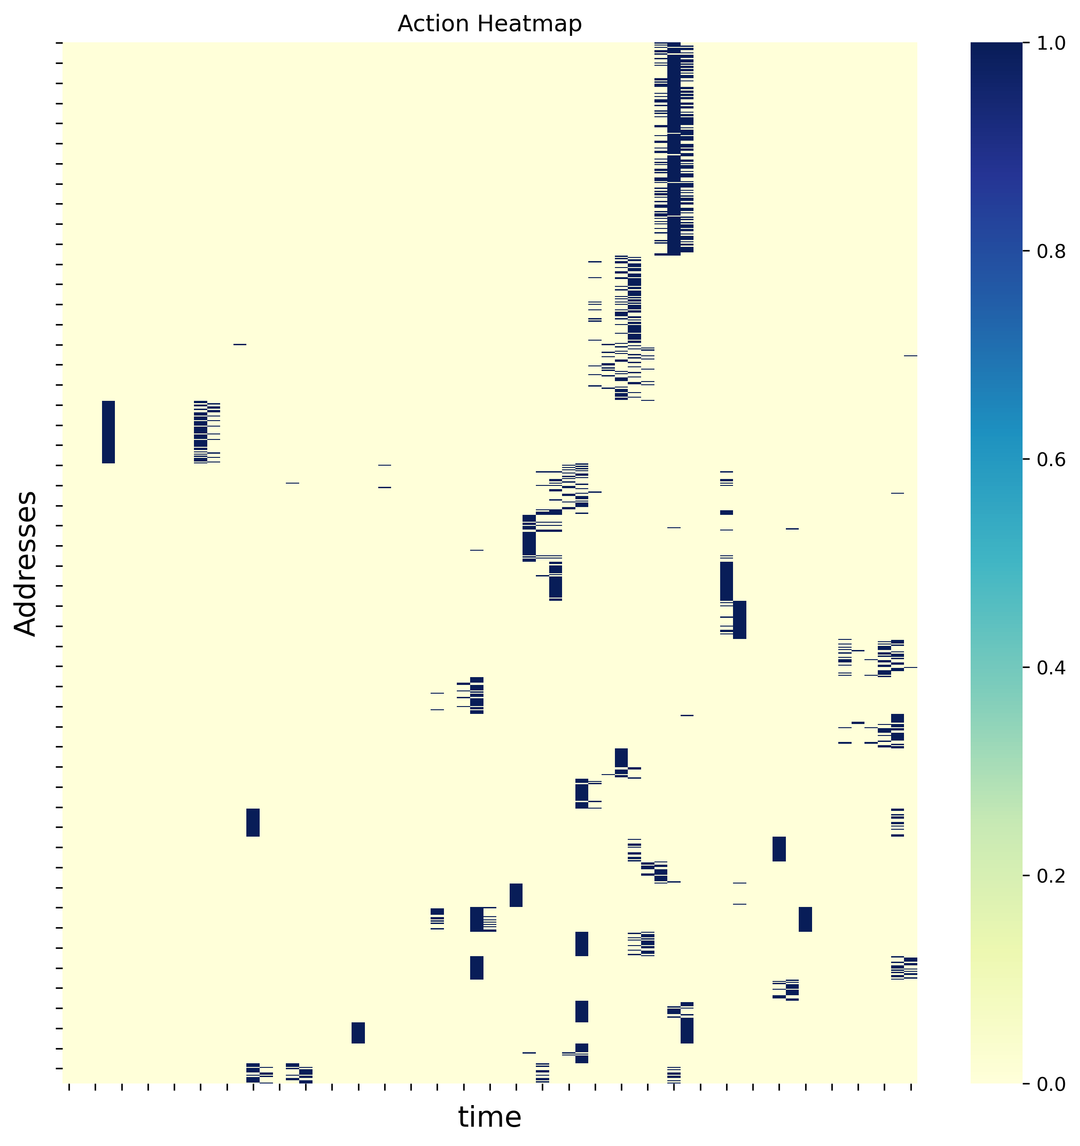
Visualization and Examinations
Heatmap visualization to represent clusters behaving in a similar way
Group 4: 56 contributors
20220907, received 0.06Eth from 56 addresses
20220909 11am-15pm, Deposit L2 with 0.055Eth
On zkSync, they all
Mint NFT
Swap some ETH for DAI
Donate GR15
Group 4
Group 27: 19 contributors
20220912, received 0.06Eth for the 1st time
20220912 Deposit L2 with 0.055Eth
On zkSync, they all
Mint NFT
Swap the same amount ETH for DAI
Donate GR15
20220924 On L1, Interact with Socket:Registry
Group 27
Notes:
Heatmap is a useful visualization to represent clusters behaving in a similar way. In our visualization, each row corresponds to an address. The column represent the discretized times. It is basically an matrix. So, if the address performed some actions at that time, the cell is then highlighted. Because we sort all the addresses by the clustering results and draw heatmap, you can see there are obvious hot areas. The cluster of addresses act at almost the same time. The heatmap provide an overall picture of the clusters. It also helps us to examine our results. For example, in the group 4, there are 56 contributors, the actions sequences is (1) received 0.06Eth from 56 addresses; Deposit L2 with 0.055Eth. And then On zkSync, they all Mint NFT - Swap some ETH for DAI – and Donate GR15. The group 27 also has similar behavior. But it is obvious from the heatmap, the group 27 waited for some more time (12 days) than group 4 (2 days) to make donations after they get fund.

Slide 30
Introduction
Team
Deliverables (github & demo video)
Our Works
Data Preparation
Topic 1：Bulk Transfers & Donations
Topic 2： Sequential Behavior Pattern Mining
Topic 3 ： Asset-Transfer Graph Mining
Topic 4: Grant Fraud
Summary, Suggestion and Future Works
Agenda
Notes:
We move to the next topic, that is, Asset-transfer graph mining.

Slide 31
Asset-Transfer Graph (ATG)
Asset-Transfer Graph (ATG) represents the relationship between Contributors, Grants(Gitcoin), Fund Suppliers and Residual Collectors in terms of their asset (ETH, MATIC and ERC20 tokens) transfers.
C
C
C
C
C
C
C
… …
… …
C
C
Fund Supplier
C
Residual Collector
C
C
C
g
G
C
C
Phase1： Fund Preparation
Fund Supplier transfers funds
to 1 or more contributors
Phase 2：Donation
Contributors transfer fund to grant Gitcoin to make donations
Phase 3： Residual Collection
After donation, contributors transfers residual fund to residual collector
Notes:
We define the concept of ATG, asset-transfer graph to be the graph representing the relationships between Contributors, Grants(Gitcoin), Fund Suppliers and Residual Collectors in terms of their asset (ETH, MATIC and ERC20 tokens) transfers. Here are the explanations of the entities’ roles. In the phase of fund preparation, the wallet responsible for supplying fund to sybils is called fund supplier. In the phase of donations, all the contributors transfers fund to grant directly on zkSync or to Gitcoin on ethereum L1 through a smart contract. After donation, contributors transfers residual fund to residual collector in phase 3. All the fund flow forms an overall graph. How to construct the graph?

Slide 32
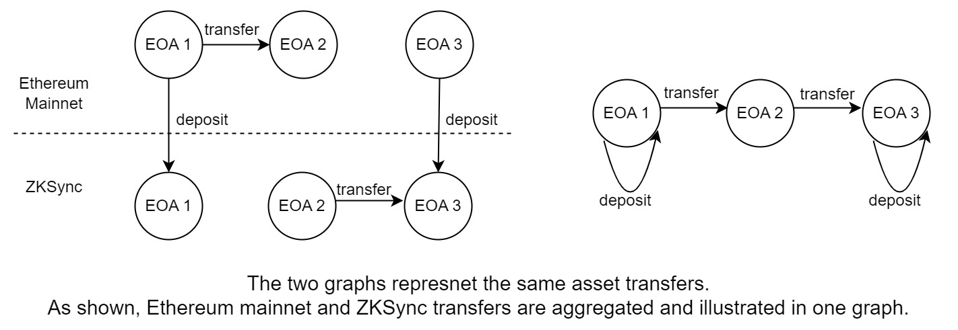
Overall Graph Constructions
Asset-Transfer: Transfers from A → B where A OR B is a contributor
Include the Assets = ETH, USDC, USDT, DAI on Ethereum, Polygon and zkSync
Date: Sept 1st - Oct 19th ATGraph Size: 1.4M edges
Notes:
How to collect data to construct the ATG of interest? We are concerned about the transfers from A to B where A or B is a GR15 contributor. In terms of the CHAIN, Ethereum L1，polygon and zkSync L2 are included. We kind of expand the time range by considering the time from sep 1st to Oct 19th. In current analysis, we only take in consideration the assets such as ETH, USDC, USDT,and DAI. The resulting graph has 1.4M edges.
It is a question whether we should construct the graph in a cross-chain manner. The answer is positive and here is an illustration. In the diagram shown to the left, EOA1 transferred fund to EOA2 on L1 and the EOA2 transferred fund to EOA3 on L2. And both EOA1 and EOA3 deposited from L1 to L2. In the graph, the EOA1 and EOA2 are disconnect. If we combine the data from both L1 and L2, the resulting graph to the right shows that all the three EOAs are connected, which is more informative.

Slide 33
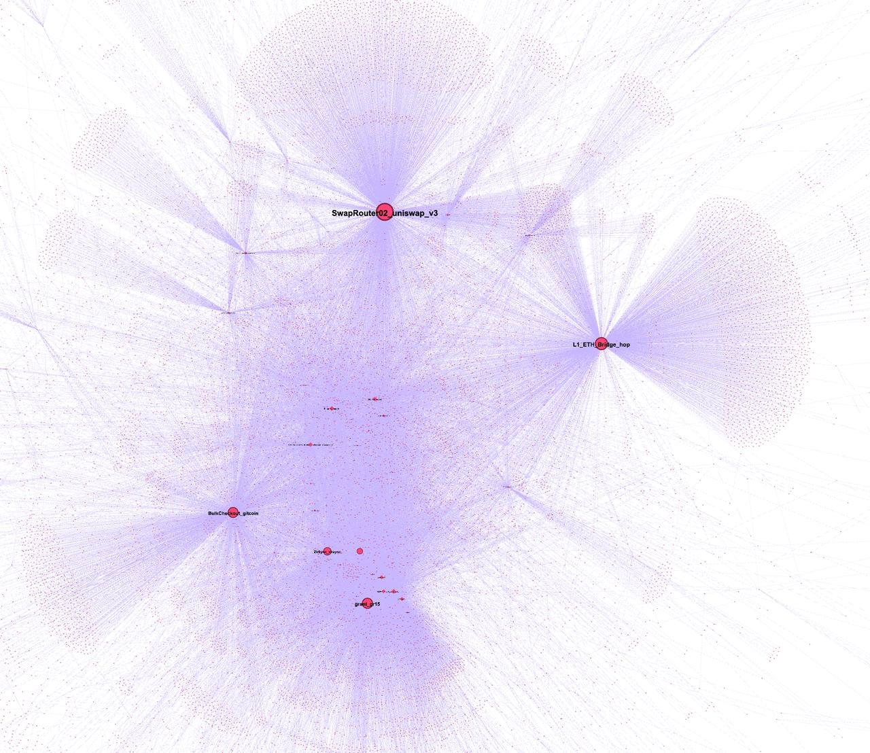
Overall Graph Visualization
HUB | Label | Degree
0x7d655c57f71464b6f83811c55d84009cd9f5221c | BulkCheckout_gitcoin | 52201
0x00000000006c3852cbef3e08e8df289169ede581 | Seaport_seaport | 33926
0xc098b2a3aa256d2140208c3de6543aaef5cd3a94 | FTX Exchange 2_ | 30229
0xabea9132b05a70803a4e85094fd0e1800777fbef | ZkSync | 17618
0x283af0b28c62c092c9727f1ee09c02ca627eb7f5 | ETHRegistrarController_3nameservice | 17150
0x68b3465833fb72a70ecdf485e0e4c7bd8665fc45 | SwapRouter02_uniswap_v3 | 17035
0xc02aaa39b223fe8d0a0e5c4f27ead9083c756cc2 | WETH9_zeroex | 9765
0x4d9079bb4165aeb4084c526a32695dcfd2f77381 | Ethereum_SpokePool_across_v2 | 9326
0x5bf5bcc5362f88721167c1068b58c60cad075aac | ProofOfStake_Pages_vitaliks_book | 8919
0xff1f2b4adb9df6fc8eafecdcbf96a2b351680455 | RollupProcessor_aztec_v2 | 8301
0x4dbd4fc535ac27206064b68ffcf827b0a60bab3f | Inbox_arbitrum | 8198
0xb8901acb165ed027e32754e0ffe830802919727f | L1_ETH_Bridge_hop | 6181
0x20f780a973856b93f63670377900c1d2a50a77c4 | ERC721OrdersFeature_element_ex | 5288
0xdef1c0ded9bec7f1a1670819833240f027b25eff | ExchangeProxy_zeroex | 4684
Visualization using Gephi: The open graph viz platform
Notes:
Here is a sample of 40,000 edges from the overall graph, visualized by Gephi. Gephi is the open graph viz platform. (Demo: open an gephi project) and the graph can layout automatically and you can drag and move one or a group of nodes. It can also compute some statistics and do simple analysis.) Gephi empowers us to finish a lot of visualizations, trackings, analysis. We strongly suggest to use Gephi. Commonly, the visualization of this graph looks messy because there are some hub nodes. We provide a list of hubs here and on github.

Slide 34
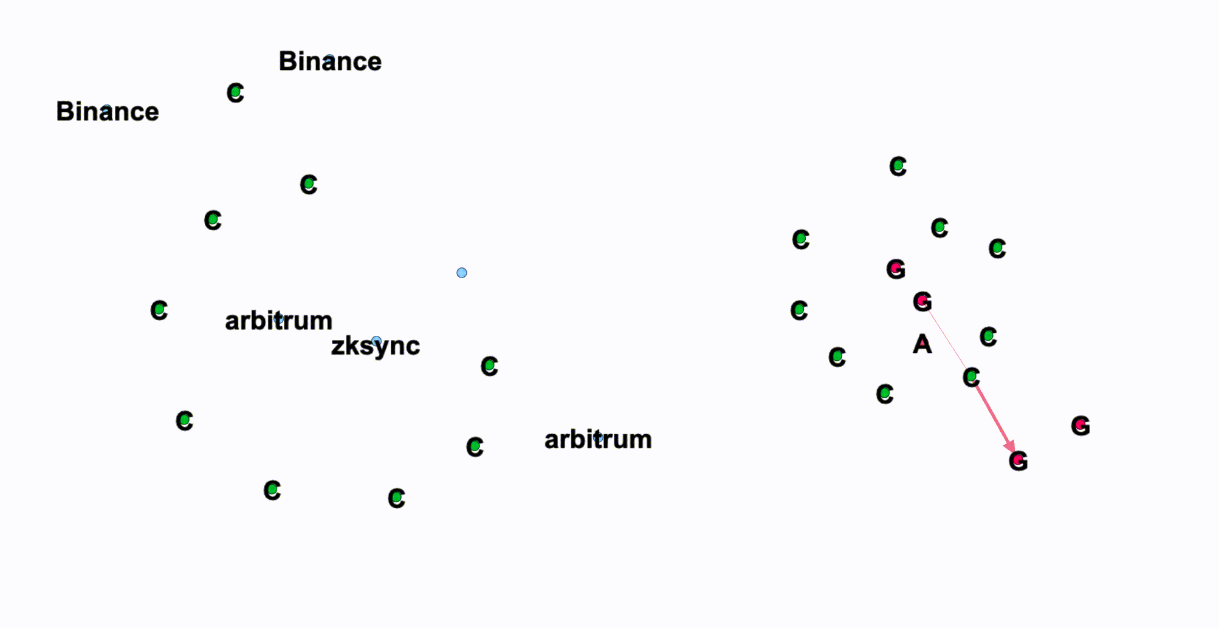
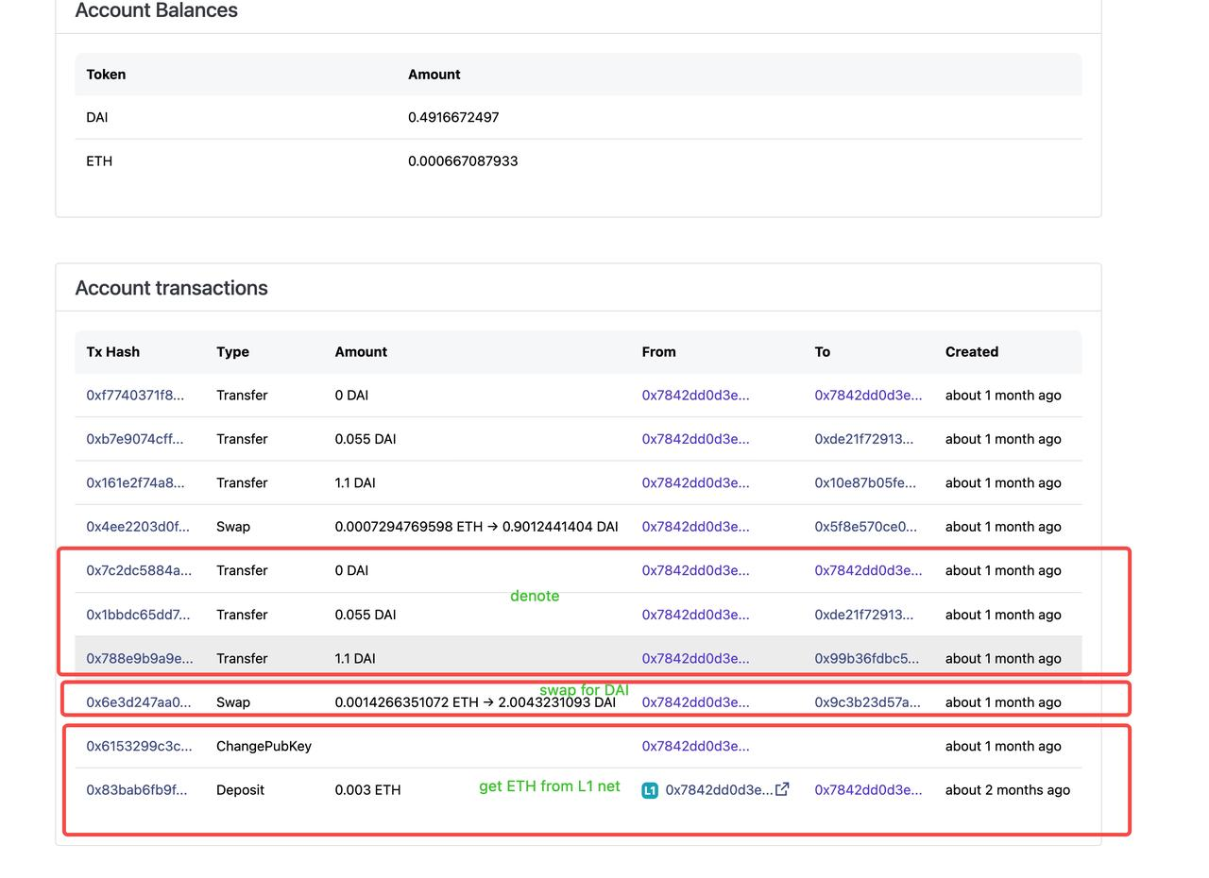
Example 1: Chain-Like Attack
L1:
ETH from Binance to the first contributor
ETH goes through the 9 Contributors in turn
L2:
Deposit to L2, and then Swap to DAI
Donate
Notes:
Example 1 shows an attack called Chain-Like attack. First, eth are transferred from BINANCE to the first contributor. And the fund is then distributed among the 9 addresses one by one, forming a chain. Finally, the fund is deposited to L2, swapped to DAI and donated to Gitcoin. This chain-like attack represents a typical way for Sybils to distribute fund.

Slide 35
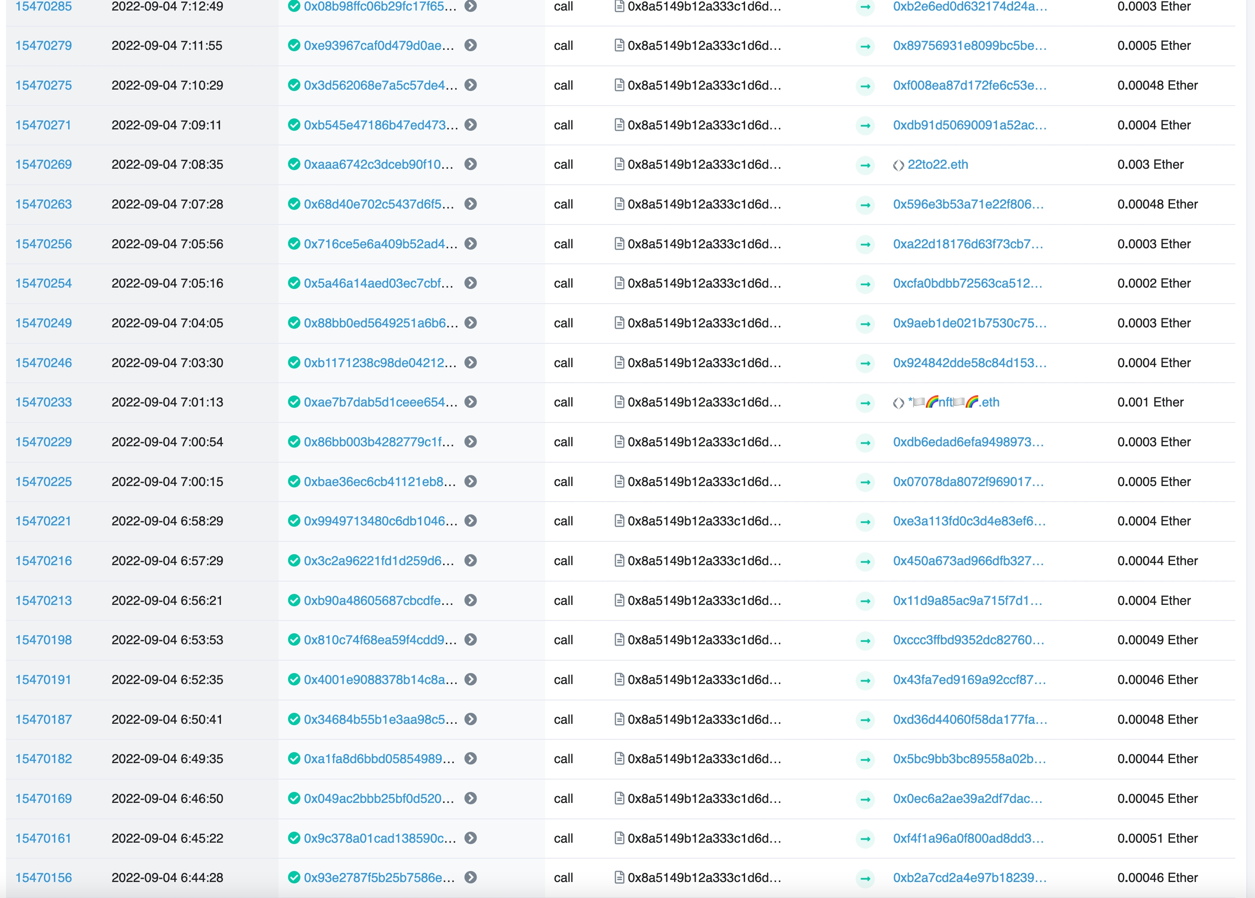
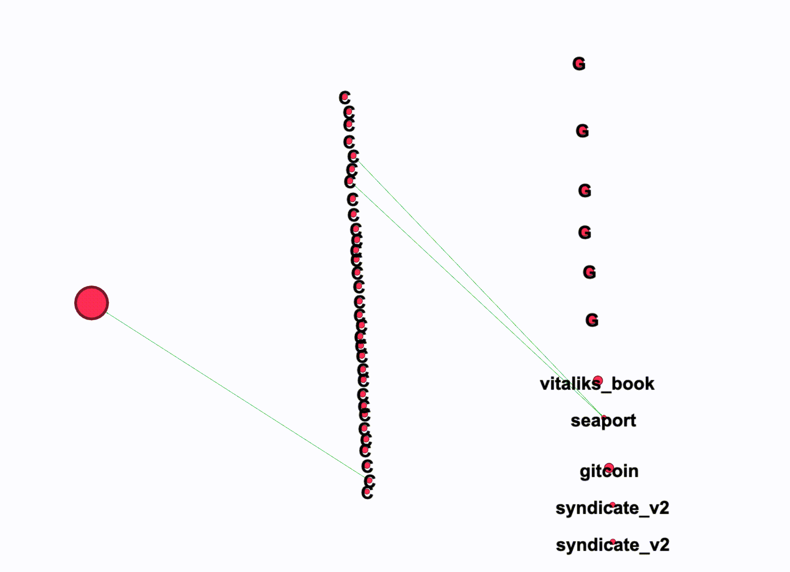
Example 2: Diamond Attack
Diamond Attack:
Sep 3rd 1 address distributed ETH to 32 contributors
Donate ProofOfStake by Vitalik, GR15(6 grants)
Notes:
Example 2 shows an attack called Diamond attack. On Sep 3rd , eth are transferred from the red address(the left one) to 32 contributors. Then they first made bulk donations to proofofstake, the book by vitalik; and then 6 GR15 grants. All the paths from the fund supplier and the grants form a diamond-like shape. This diamond-like attack represents another typical way for Sybils to distribute funds and make donations.

Slide 36
Pipeline
Staring from the overall graph
Remove HUB addresses and smart contracts
Compute Weakly-Connect Components
For every WCC
Examine whether it contains Chain-Like attacks OR Diamond attacks
Visualize possible Chain-Like attacks and Diamond attacks using Gephi
Manually double check them
Finally we have 150 Connect Components
Through carefully investigation, 2170 Addresses in the CCs are judged as Sybils (Risk = HIGH)
The heuristic to examine Chain is to prune branches so that the trunk is left as a Chain.
The key to find Diamond is to find the Fund Supplier with great out-degree and out-flow
Notes:
Here is the pipeline we are following for seeking more patterns like Chain and Diamond. Staring from the overall graph, we remove HUB addresses and smart contracts and then compute weakly-connect components. Then for every Connect Component, we examine whether it contains Chain-Like Attacks OR Diamond Attacks. The examination is based on some simple heuristics. First, to examine chain, we can prune possible branches to see whether the left backbone is a Chain. The key to find Diamond is to find the Fund Supplier with great out-degree and out-flow. Once the possible chain-like and diamond attacks are detected, we visualize them using Gephi and manually check whether they are real attacks. By doing so, there 150 connected components found. And 2171 addresses in these connected components are judge as Sybils for sure.

Slide 37
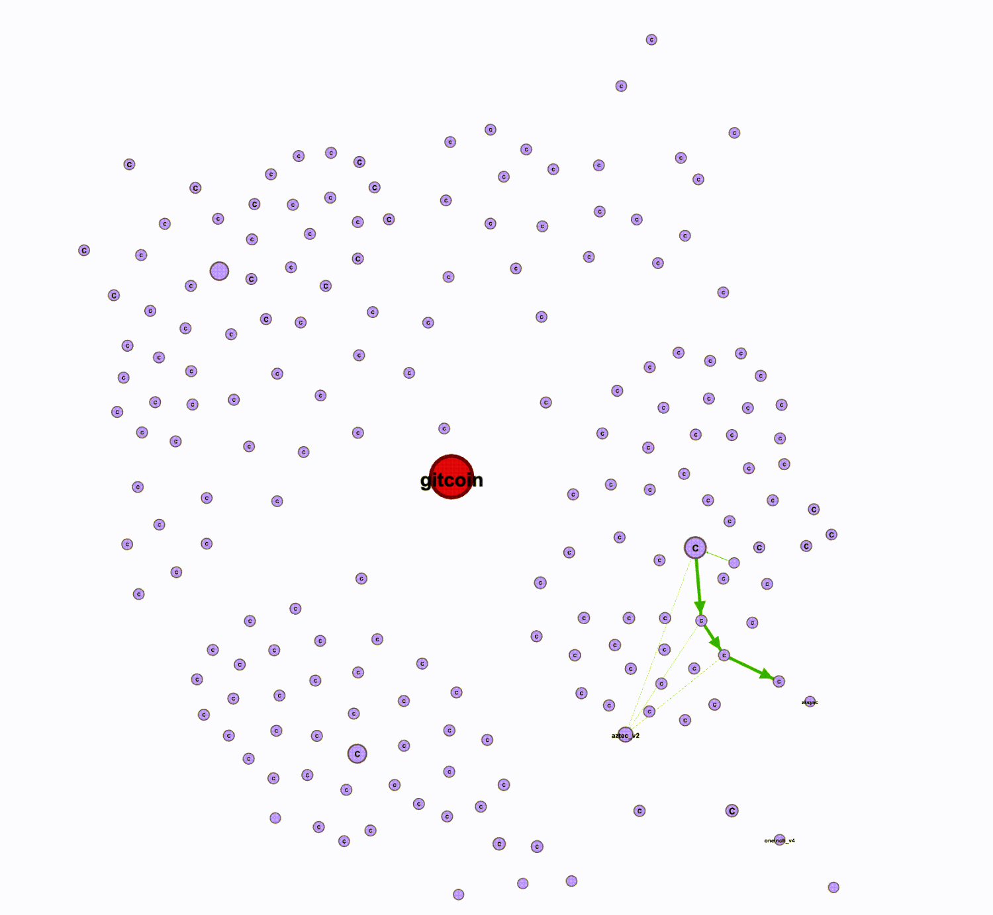
Example 3: Cluster With 188 Sybils
ClusterID=0 with 188 Addresses; Attack on Ethereum；
Fund Preparation:
Two addresses 0xede41(2022-09-14 9:25:49) and 0xb8308(2022-09-14 10:35:30) distributed fund in a Chain-like way.
Making Donations:
With fund received, every address first made a donation of about 1USD, and then sent fund to the next.
Residual Collection:
After conducting attacks on Aztec and zkSync, all the residual funds are collected on sep 26th to three addresses on zkSync 0x45997, 0xede41 and 0xb8308.
Notes:
Here is the largest cluster with 188 sybils. The attack happened on Ethereum；
In the Fund Preparation phase, Two addresses 0xede41(2022-09-14 9:25:49) and 0xb8308(2022-09-14 10:35:30) distributed fund in a Chain-like way. With fund received, every address first made a donation of about 1USD, and then sent fund to the next. In the Residual Collection phase, after conducting attacks on Aztec and zkSync, all the residual funds are collected on sep 26th to three addresses on zkSync 0x45997, 0xede41 and 0xb8308.

Slide 38
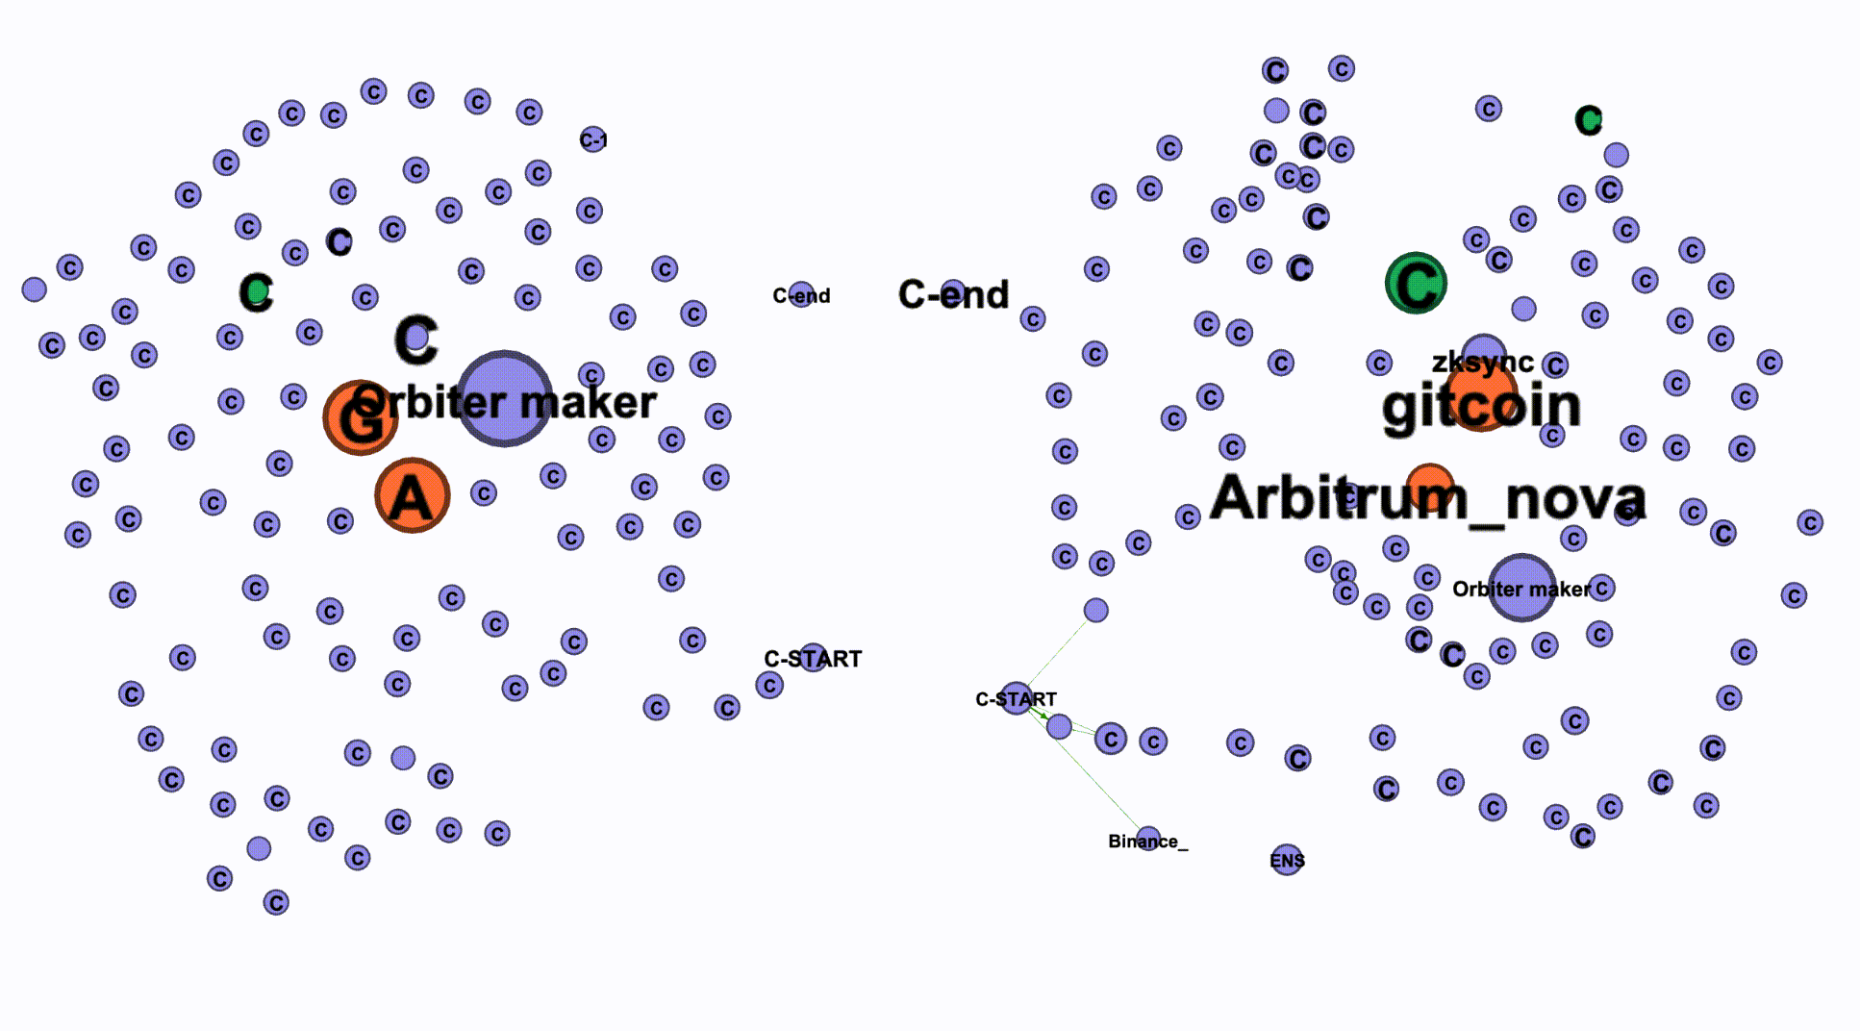
Example 4: Cluster With 98 Sybils
ClusterID=1；98 Addresses；
On Ethereum and zkSync simultaneous
Fund Preparation:
Address C-START distributed funds in a Chain-like way, respectively on L1 Ethereum (09-15 16:16:23) and L2 zkSync (09-15 16:17:30)
Making Donations：
With fund received, addresses first made a donation to 2 grants, and then send funds to the next.
Residual Collection:
The last address along the chain transferred all residual funds back to C-START on Ethereum.
0xa214c
Chain Attack on Ethereum
Chain Attack on zkSync
Notes:
Here is the cluster with 98 sybils. The attack happened on Ethereum and zkSync as well. Started from the address named C-Start，funds are distributed in a Chain-like way, respectively on L1 Ethereum (09-15 16:16:23) and L2 zkSync (09-15 16:17:30). With fund received on both L1 and L2, addresses first made a donation to 2 grants, and then send funds to the next address. Lastly, the final address along the chain transferred all residual funds back to C-start on Ethereum.

Slide 39
Introduction
Team
Deliverables (github & demo video)
Our Works
Data Preparation
Topic 1：Bulk Transfers & Donations
Topic 2： Sequential Behavior Pattern Mining
Topic 3 ： Asset-Transfer Graph Mining
Grant Fraud
Summary, Suggestion and Future Works
Agenda
Notes:
Grant fraud is an important topic deserving another hackthon. Due to time limit, we only spend half day to manually find one possible grant fraud. The important thing is to present the ideas behind.

Slide 40
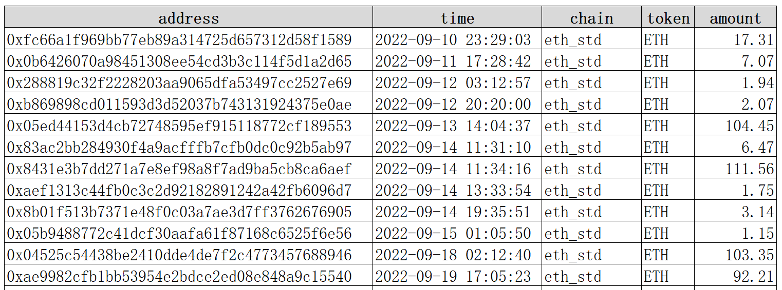
Grant Fraud
Basic Info
Attack Details
Grant ID：7419
Contributors: 29
Grant Address：0xfd9f8a0f4bdeac72f08af1c708023cc31dd2e3be
Supply funds to EOAs (29 transfers）
Reasoning
………
(1)The grant address transferred fund to 29 EOAs ，and then (2) manipulated the EOAs to make donations back to itself
Bulk donations (39 donations）
Contrib1
Transfer
Contrib2
Donate
Grant
Address
Transfer
………
7419
Donate
…
Transfer
Donate
Contrib29
Notes:
The grant we are talking about is grant 7419. Every grant has a grant address to receive donations from contributors. We find that the grant address first transferred funds to 29 contributor addresses in a diamond-like way. And then all the contributors are manipulated to make donations to a grant, which is the grant 7419. We do not believe it is an coincidence. We believe it is an attack in order to gain illegitimate matching allocation.
github_project_url:None
title:Barichara Regeneration Fund – Prototyping a Bioregional Regenerative Economy
twitter_handle_1:cognitivepolicy
twitter_handle_2:cognitivepolicy
website:https://www.regeneratebarichara.org/
grant_address(收款地址):0xFd9F8A0f4bdEaC72F08AF1c708023cC31dD2E3BE
total_contribution_count（总捐赠笔数）:321
total_contribution_address_count（总捐赠Address数）:287

Slide 41
Introduction
Team
Deliverables (github & demo video)
Our Works
Data Preparation
Topic 1：Bulk Transfers & Donations
Topic 2： Sequential Behavior Pattern Mining
Topic 3 ： Asset-Transfer Graph Mining
Grant Fraud
Summary, Suggestion and Future Works
Agenda

Slide 42
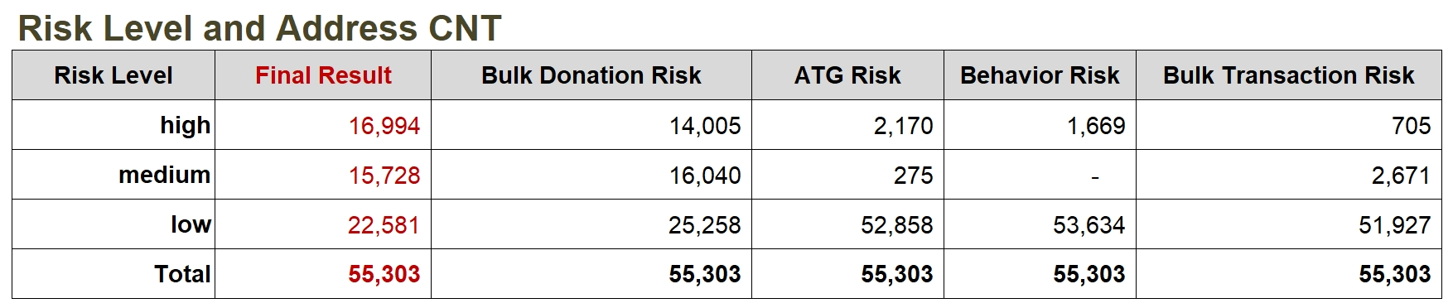
Summary and Future Works
Transfer
Summary
We propose and develop four approaches, namely bulk transfers pattern mining, bulk donations pattern mining, asset-transfer graph mining, sequential behavior pattern mining for slaying sybil. These approaches form a systematic algorithmic LEGO and totally find 16,994 High Risk Sybils. Besides, we make our first attempt to detect grant fraud and find one case.
Future works
Due to time limit, some of the algorithms used in this work is not state-of-art. We can have more deep studies.
It would be very grateful if we can access Gitcoin exclusive data , e.g. ip, wifi, user behavior on Gitcoin etc.

Slide 43


